Slide 1

مبانی داده کاوی
کیفیت داده و پاکسازی داده ها
بهشیـد بهکمـال
نیمسال اول 1400-1399
Notes:
6

Slide 2
Data Quality
What is Data Quality?
Data Quality Dimensions & Models
Where do problems come from
Types of Data Quality Problems
How can they be resolved
Data Cleaning Methods
Summary

Slide 3
Definitions
data quality
Data quality refers to the level of quality of data.
There are many definitions of data quality but data are generally considered high quality if "they are fit for their intended uses in operations, decision making and planning.
The Quality of a Data Product may be understood as the degree to which data satisfy the requirements defined by the product-owner organization.

Slide 4
Data Quality Dimensions

Slide 5
ISO/IEC 25012 Data Quality Model
The ISO/IEC-25012 data quality model defined quality attributes into fifteen characteristics considered by two points of view:
Inherent
data quality refers to data itself, in particular to:
data domain values and possible restrictions
relationships of data values
Metadata
system dependent
data quality depends on the technological domain in which data are used:
- computer systems' components such as: hardware devices (precision)
- computer system software (recoverability)
- other software (portability)

Slide 6
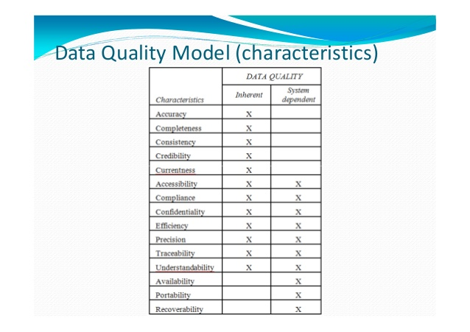

Slide 7
1. Accuracy
The degree to which data has attributes that correctly represent the true value of the intended attribute of a concept or event in a specific context of use.
Syntactic accuracy
Semantic accuracy
Measurement Function A/B
A: records in which all attributes are accurate
B: Total records in a dataset
A=number of records with the specified field syntactically accurate
B=number of records
A: attribute values that are accurate
B: records × attributes

Slide 8
2. Completeness
The degree to which subject data associated with an entity has values for all expected attributes and related entity instances in a specific context of use.
Measurement Function A/B
A: records with no missing attribute
B: Total records in a dataset
A: number of data required for the particular context in the data file
B: number of data in the specified particular context of intended use
A: attribute fields containing values
B: records × attributes

Slide 9
3. Consistency
Free from contradiction and are coherent with other data in a specific context of use.
EXAMPLE An employee's birth date cannot be later than his “recruitment date”.

Slide 10
4. Creditability (validity)
Validity is a weakened but more readily measured form of accuracy.
Attribute values may be valid without being correct, but not vice versa.
An attribute value is valid if it falls in some external sources defined and domain-knowledge dependent set of values.
Validity can range from
Mechanical (Example:18/19/2002 is not a well-formed and not a valid date)
Logical (Example: -5 is not a valid age)
Domain-derived (Example: 1234 pounds is not a valid weight for a person)
Task dependent: 16:12 may be a valid time in one database but not in another

Slide 11
5. Currentness
The degree to which data has attributes that are of the right age in a specific context of use.
EXAMPLE The timetable of a railway station must be updated with the frequency required to allow passengers to take a train even if the scheduled time or platform change.

Slide 12
از اسلاید 13 تا 22 برای مطالعه بیشتر

Slide 13
6. Accessibility
The degree to which data can be accessed in a specific context of use, particularly by people who need supporting technology or special configuration because of some disability.
EXAMPLE Data that should be managed by a screen reader cannot be stored as an image.

Slide 14
7. Compliance
The degree to which data has attributes that adhere to standards, conventions or regulations in force and similar rules relating to data quality in a specific context of use.
EXAMPLE: Credit risk data of a bank must comply with specific laws and standards.

Slide 15
8. Confidentiality
Ensure that it is only accessible and interpretable by authorized users in a specific context of use.
Confidentiality is an aspect of information security (together with availability, integrity) as defined in ISO/IEC 13335-1:2004.
EXAMPLE: Data that refers to personal or confidential information like health or profit must be accessed only by authorized users or should be written in secret code.

Slide 16
9. Efficiency
The degree to which data has attributes that can be processed and provide the expected levels of performance by using the appropriate amounts and types of resources in a specific context of use.
EXAMPLE: Using more space than necessary to store data can cause waste of storage, memory and time.

Slide 17
10. Precision
The degree to which data has attributes that are exact or that provide discrimination in a specific context of use.
Look for rounding errors. Exp. precision of 5 decimal places allows different functionalities rather than a precision of 2 decimal places
Precision in location latitude and longitude declarations: must contain seconds in the Degree/Minute/Second system.

Slide 18
11. Traceability
Provide an audit trail of access to the data and of any changes made to the data in a specific context of use.
EXAMPLE: Public administrations must keep information about the access executed by users for investigating who read/wrote confidential data.

Slide 19
12. Understand ability
Enable data it to be read and interpreted by users, and are expressed in appropriate languages, symbols and units in a specific context of use.
Some information about data understandability are provided by metadata.
EXAMPLE: To represent a State (within a country), the standard acronym is more understandable than a numeric code.

Slide 20
13. Availability
Enable data to be retrieved by authorized users and/or applications in a specific context of use.
A particular case of availability is concurrent access (both to read or to update data) by more than one user and/or application.
Another case of availability is the capability of data to be available for a specific period of time.
SYSTEM DEPENDENT Data Quality Measure for Data items availability
• Measurement Function A/B
A=Number of data items available during backup/restore activities
B=Number of data items of backup/restore procedures

Slide 21
14. Portability
Enable data to be installed, replaced or moved from one system to another preserving the existing quality in a specific context of use.
SYSTEM DEPENDENT Data Quality Measure for Data portability
• Measurement Function A/B
A=number of data that preserved the existing quality attribute after the migration to a different computer system
B=number of data migrated

Slide 22
15. Recoverability
Enable data to maintain and preserve a specified level of operations and quality, even in the event of failure, in a specific context of use.
Recoverability can be provided by features like commit/synch point, rollback (fault-tolerance capability) or by backup-recovery mechanisms.
EXAMPLE: When a media device has a failure, data stored in that device should be recoverable.
SYSTEM DEPENDENT Data Quality Measure for Recoverability
• Measurement Function A/B
A= number of data items successfully backed up/restored during backup /restore operation
B= number of data items of backup/restore procedures

Slide 23
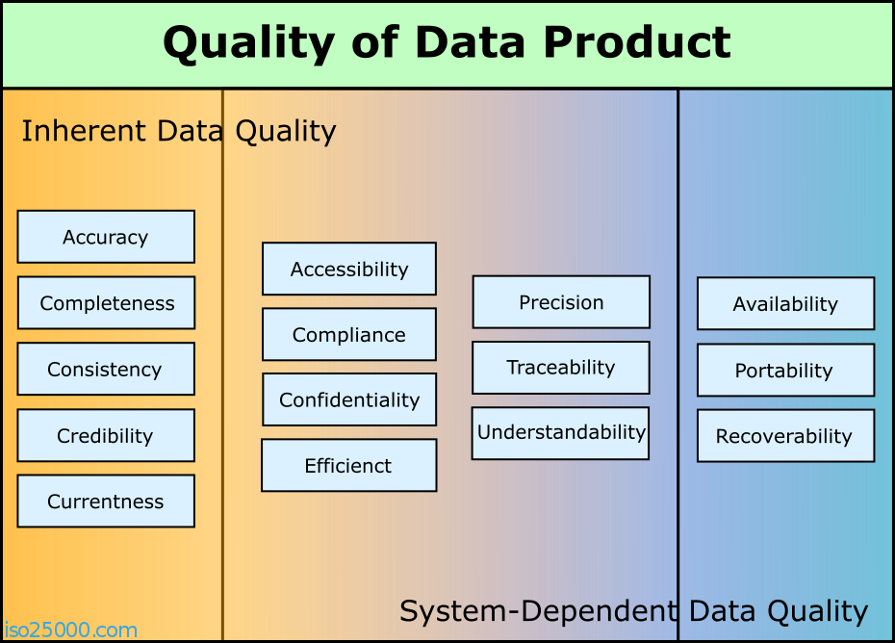
ISO 25012 Quality Model

Slide 24
Data Quality
Problems

Slide 25
Classification of Data Quality problems
Data Quality Problem
Single Source Problems
Multi Source Problem
Multi Source Problems
Single Source Problem
Schema Related
Schema Related
Schema Related
Schema Level
Instant Level
Schema Level
Instant Level
(Lack of Integrity Constraints,
Poor Schema Design)
- Uniqueness
- Referential Integrity
…..
(Data Entry Error)
- Misspelling
- Redundancy
- Contradictory Value
….
(Heterogeneous
Data Models &
Schema Design)
- Naming Conflicts
- Structural Conflicts
.....
(Overlapping
Contradictory
& inconsistent Data)
- Inconsistent Aggregation
Inconsistent Timing
….

Slide 26
Single Source Problem - Schema Level

Slide 27
Single Source Problem – Instance Level

Slide 28
Multi Source Problem – Schema & Instance Level

Slide 29
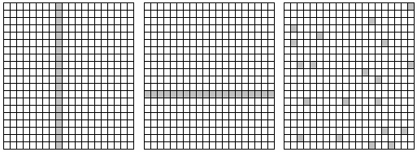
Randomness of data errors
All three cases would report the same accuracy percentage but represent significantly different degrees of quality.

Slide 30
Data Cleaning

Slide 31
Data Cleaning tasks
Fill in missing values
Identify outliers and smooth out noisy data
Correct inconsistent data

Slide 32
Missing Data
Data is not always available
E.g., many tuples have no recorded value for several attributes, such as customer income in sales data
Missing data may be due to
equipment malfunction
inconsistent with other recorded data and thus deleted
data not entered due to misunderstanding
certain data may not be considered important at the time of entry

Slide 33
How to Handle Missing Data?
1. Ignore the tuple
usually done when class label is missing (assuming the tasks in classification—not effective when the percentage of missing values per attribute varies considerably)
2. Fill in the missing value manually: tedious + infeasible?
3. Fill in the missing value automatically:
Use a global constant: e.g., “unknown”, “NA” a new class?!
Use the attribute mean: for all samples belonging to the same class: smarter
Use the most probable value: inference-based such as Bayesian formula or decision tree

Slide 34
Noisy Data
Noise: random error or variance in a measured variable
Incorrect attribute values may due to
faulty data collection instruments
data entry problems
data transmission problems
technology limitation
inconsistency in naming convention
Other data problems which requires data cleaning
duplicate records
incomplete data
inconsistent data

Slide 35
How to Handle Noisy Data?
Binning (e.g., 4, 8, 9, 15, 21, 21, 24, 25, 26, 28, 29, 34)
First sort data and partition into (equal-frequency) bins
4, 8, 9, 15
21, 21, 24, 25
26, 28, 29, 34
Then
smooth by bin means:
9, 9, 9, 9
23, 23, 23, 23
29, 29, 29, 29
smooth by bin boundaries:
4, 4, 4, 15
21, 21, 25, 25
26, 26, 26, 34

Slide 36
How to Handle Noisy Data?
Regression
smooth by fitting the data into regression functions
Clustering
detect and remove outliers
Combined computer and human inspection
detect suspicious values and check by human (e.g., deal with possible outliers)

Slide 37
Summery
Data Quality Dimensions & Models
Data Quality Problems
Instance/ Schema Level
Singe/ Multi Source
Attribute/ Record/ Record Type/ Source
Data Cleaning Tasks
Fill in missing values
Identify outliers and smooth out noisy data
Correct inconsistent data

Slide 38


